Slide 1
DASC 5301-002
Bayes Classifier and Naïve Bayes Classifier
Dr Subharag Sarkar
Fall 2023
Slides Courtesy - Rózsa Záruba

Slide 2
Introduction

Slide 3
Introduction
Let’s Assume you are working on a classification problem.
You have generated a set of hypotheses.
Created features for the dataset.
Discussed the importance of variables.
Within an hour, stakeholders want to see the first cut of the model.
What will you do?
Notes:
After the last point -> You have hundreds of thousands of data points and several variables in your training data set.

Slide 4
Introduction
In such situations, you need to use the Naïve Bayes Classification Technique.
Naïve Bayes Classification Technique is extremely fast relative to other classification algorithms.
It works on Bayes’ Theorem of probability to predict the class of unknown data sets.

Slide 5
Naïve Bayes

Slide 6
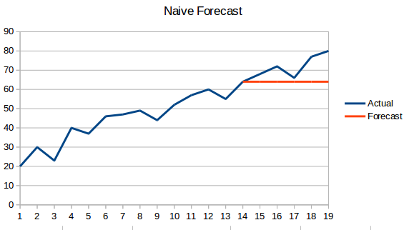
Naïve Bayes
While we may not realize this, this is the algorithm that’s most commonly used to sift through spam emails!
It applies what is known as a posterior probability using Bayes Theorem to do the categorization of the unstructured data.
And in doing so, it makes a naïve assumption that the predictors are independent, which may not be true.
The model works well with a small training dataset, provided all the classes of the categorical predictor are present.

Slide 7
Naïve Bayes
It is a classification technique based on Bayes’ Theorem with an assumption of independence among predictors.
In simple terms, a Naive Bayes classifier assumes that the presence of a particular feature in a class is unrelated to the presence of any other feature.
For example, a fruit may be considered to be an apple if it is red, round, and about 3 inches in diameter.
Even if these features depend on each other or upon the existence of the other features, all of these properties independently contribute to the probability that this fruit is an apple.
This is why it is known as ‘Naïve’.

Slide 8
Naïve Bayes
Naive Bayes model is easy to build and particularly useful for very large data sets.
Along with simplicity, Naive Bayes is known to outperform even highly sophisticated classification methods.

Slide 9

Naïve Bayes
Bayes Theorem provides a way of computing posterior probability P(A|B) from P(A), P(B) and P(B|A).
P(A|B) is Posterior probability: Probability of hypothesis A on the observed event B.
P(B|A) is Likelihood probability: Probability of the evidence given that the probability of a hypothesis is true.
P(A) is Prior Probability: Probability of the hypothesis before observing the evidence.
P(B) is Marginal Probability: Probability of Evidence.

Slide 10
How Naïve Bayes works?

Slide 11
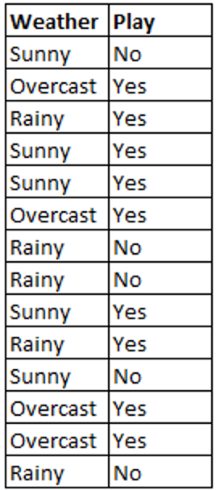
How Naïve Bayes Work?
Let’s have a training data set of weather and the corresponding target variable ‘Play’ (suggesting possibilities of playing).
Now, we need to classify whether players will play or not based on weather conditions.
Let’s follow the below steps to perform it.

Slide 12
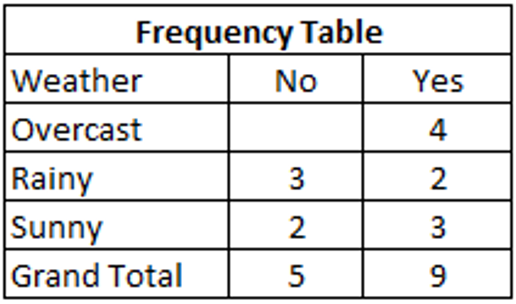
How Naïve Bayes Work?
Step 1- Convert the data set into a frequency table.

Slide 13
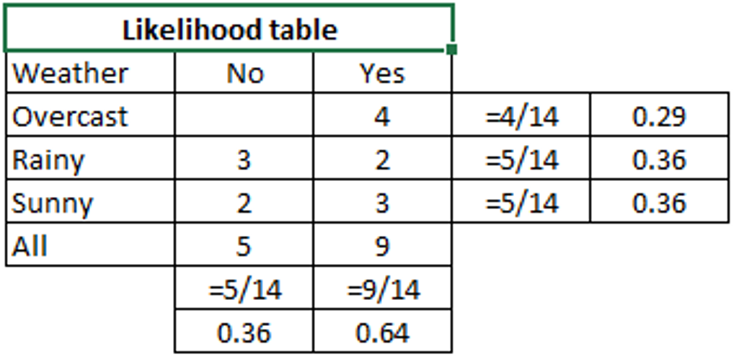
How Naïve Bayes Work?
Step 2 – Create a Likelihood table by finding the probabilities like Overcast probability = 0.29 and probability of playing is 0.64.

Slide 14
How Naïve Bayes Work?
Step 3 - Now, use the Naive Bayesian equation to calculate the posterior probability for each class.
The class with the highest posterior probability is the outcome of prediction.
Let us use this example to solve this problem.
Players will play if the weather is sunny. Is this statement correct?

Slide 15
How Naïve Bayes Work?
Players will play if the weather is sunny. Is this statement correct?
P(Yes | Sunny) = P( Sunny | Yes) * P(Yes) / P (Sunny)
Here we have
P (Sunny |Yes) = 3/9 = 0.33,
P(Sunny) = 5/14 = 0.36,
P( Yes)= 9/14 = 0.64
Now, P (Yes | Sunny) = 0.33 * 0.64 / 0.36
= 0.60

Slide 16
How Naïve Bayes Work?
Naive Bayes uses a similar method to predict the probability of different classes based on various attributes.
This algorithm is mostly used in text classification and with problems having multiple classes.

Slide 17
Types of Naïve Bayes

Slide 18
Types of Naïve Bayes
The different types of Naïve Bayes algorithms are :
Gaussian Naïve Bayes:
The Gaussian model assumes that features follow a normal distribution.
This means if predictors take continuous values instead of discrete, then the model assumes that these values are sampled from the Gaussian distribution.

Slide 19
Types of Naïve Bayes
The different types of Naïve Bayes algorithms are :
Multinomial Naïve Bayes:
The Multinomial Naïve Bayes classifier is used when the data is multinomial distributed.
It is primarily used for document classification problems, it means a particular document belongs to which category such as Sports, Politics, education, etc.
The classifier uses the frequency of words for the predictors.

Slide 20
Types of Naïve Bayes
The different types of Naïve Bayes algorithms are :
Bernoulli Naïve Bayes:
The Bernoulli classifier works similar to the Multinomial classifier, but the predictor variables are the independent Booleans variables.
Such as if a particular word is present or not in a document.
This model is also famous for document classification tasks for the predictors.

Slide 21
Types of Naïve Bayes
The different types of Naïve Bayes algorithms are :
Complement Naive Bayes:
It is an adaptation of Multinomial NB where the complement of each class is used to calculate the model weights.
So, this is suitable for imbalanced data sets and often outperforms the MNB on text classification tasks.

Slide 22
Types of Naïve Bayes
The different types of Naïve Bayes algorithms are :
Categorical Naive Bayes:
Categorical Naive Bayes is useful if the features are categorically distributed.
We have to encode the categorical variable in the numeric format using the ordinal encoder for using this algorithm.

Slide 23
Application of Naïve Bayes

Slide 24
Application of Naïve Bayes
Real-time Prediction:
Naive Bayes is an eager learning classifier, and it is sure fast.
Thus, it could be used for making predictions in real-time.
Multi-class Prediction:
This algorithm is also well known for multi-class prediction feature.
Here we can predict the probability of multiple classes of target variables.

Slide 25
Application of Naïve Bayes
Text classification/ Spam Filtering/ Sentiment Analysis:
Naive Bayes classifiers mostly used in text classification (due to better results in multi-class problems and independence rule) have a higher success rate as compared to other algorithms.
As a result, it is widely used in Spam filtering (identify spam e-mail) and Sentiment Analysis (in social media analysis, to identify positive and negative customer sentiments)

Slide 26
Application of Naïve Bayes
Recommendation System:
Naive Bayes Classifier and Collaborative Filtering together build a Recommendation System that uses machine learning and data mining techniques to filter unseen information and predict whether a user would like a given resource or not.

Slide 27
Advantages of Naïve Bayes
It is easy and fast to predict the class of test data set. It also performs well in multi-class prediction
When an assumption of independence holds, a Naive Bayes classifier performs better compared to other models like logistic regression and you need less training data.
It performs well in the case of categorical input variables compared to numerical variable(s). For numerical variables, normal distribution is assumed (bell curve, which is a strong assumption).

Slide 28
Disadvantage of Naïve Bayes
If the categorical variable has a category (in the test data set), which was not observed in the training data set, then the model will assign a 0 (zero) probability and will be unable to make a prediction.
This is often known as “Zero Frequency”.
To solve this, we can use the smoothing technique.
One of the simplest smoothing techniques is called Laplace estimation.

Slide 29
Disadvantage of Naïve Bayes
On the other side Naïve Bayes is also known as a bad estimator, so the probability outputs from predict_proba are not to be taken too seriously.
Another limitation of Naïve Bayes is the assumption of independent predictors.
In real life, it is almost impossible that we get a set of predictors that are completely independent.

